Slide 1
Asexual vs. Sexual Reproduction

Slide 2
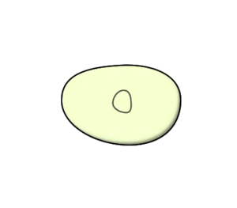
Asexual Reproduction
Asexual reproduction is the process by which a single organism produces genetically identical offspring.
This type of reproduction is most common in single cell organisms like bacteria, but can be found in more complex organisms as well.

Slide 3
Benefits of Asexual Reproduction
Rapid population growth
Requires less energy to reproduce
All organisms are capable of reproduction (not just the females of the species)
One organism can make a whole population
Less likely to become extinct
Each offspring is a genetic copy of the parent

Slide 4
Disadvantages of Asexual Reproduction
The primary disadvantage of asexual reproduction is:
THERE IS NO GENETIC DIVERSITY!
This means that a population of genetically identical organisms is more susceptible to disease and can’t adapt easily to a changing environment.

Slide 5
Types of Asexual Reproduction
There are four main types of asexual reproduction:
Binary Fission
Budding
Vegetative Propagation
Regeneration

Slide 6
Binary Fission
Binary fission occurs when one parent splits into two offspring.
This is how all bacteria and some single celled protists reproduce.

Slide 7
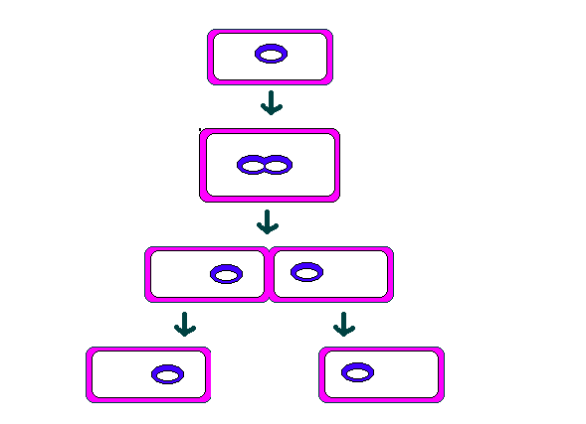
Binary Fission
The elongates and the cell’s
chromosomes are copied →
A new cell wall is formed→
The cell separates into
two new daughter cells→

Slide 8
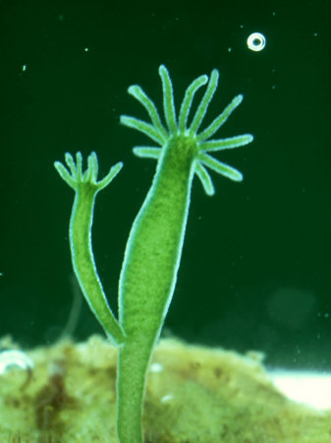
Budding
Budding occurs when a new organism grows off a parent.
Simple organisms such as some protists and some simple eukaryotes reproduce by budding.
A simple protist called a hydra reproduces by budding.

Slide 9
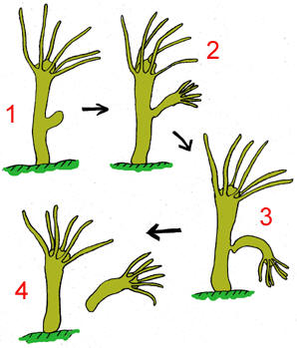
Budding

Slide 10
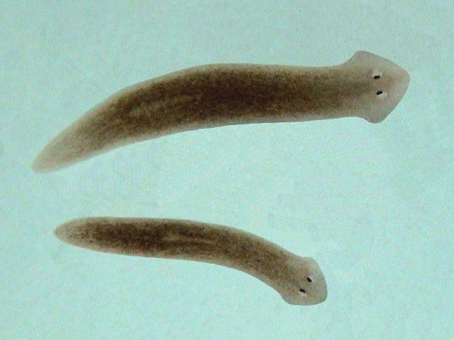
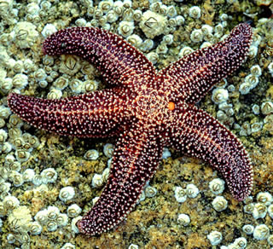
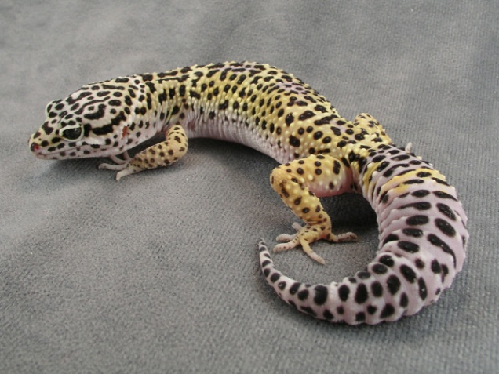
Regeneration
Regeneration occurs when an organism can regrow a lost limb or can grow a whole other organism on a cut off piece.
This is common in simple multicellular creatures such as worms, sea stars or geckos.

Slide 11
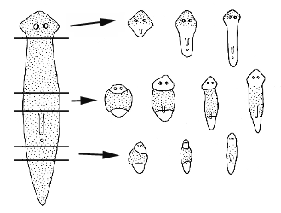
That is a lot of worm…
Planarians are marine flatworms. Each slice of a planarian can grow into a brand new flatworm!

Slide 12
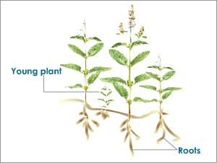
Vegetative (Plant) Propagation
Vegetative propagation occurs when a new plant grows off an existing part of an old plant.
Many plants can use vegetative propagation.
Ivy
Grasses
Potato plants
Strawberries
Spider plants

Slide 13
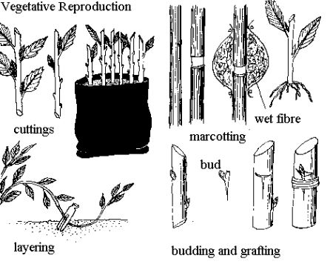
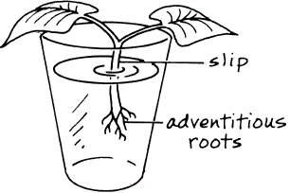
We use vegetative propagation ALL the time!

Slide 14
Sexual Reproduction
Sexual reproduction requires two organisms.
Each organism has specialized sex cells called gametes.
Animals have sperm (male) and ovum (female).
Plants have pollen (sperm) and ovum (egg).
Sexual reproduction happens when the two sex cells fuse together (fusion) to create a new and genetically different offspring.

Slide 15
Meiosis
Meiosis- process which gametes are formed.
Meiosis is cell division that halves the number of chromosomes. The gametes come together in fertilization so the new cell has the correct number of chromosomes
Notes:
15

Slide 16
Sexual Reproduction
Haploid cells are called gametes -sex cells
Sperm - male gametes (n)
Eggs – female gametes (n)
Zygote – a cell resulting from the fertilization of the egg by a sperm (2n)
The zygote can develop into a multicellular organism by mitosis
Notes:
16

Slide 17
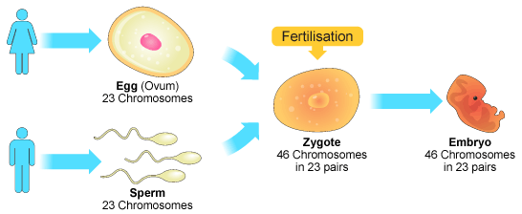
Sexual Reproduction
Fertilization (fusion)

Slide 18
Advantages of Sexual Reproduction
Sexual reproduction allows for more genetic diversity in the offspring.
More adaptability
More variation
Greater chance of mutation
Greater chance of survivability when faced with environmental change

Slide 19
How many different kinds of gametes can an organisms produce?
Human
23 pair chromosomes
Each of 23 pairs can line up at the equator in two different ways (2²³)
More than 8 million different kinds of sperm are possible
When fertilization occurs, 2²³ X 2^{23,} or 70 trillion different zygotes are possible!
Notes:
19

Slide 20
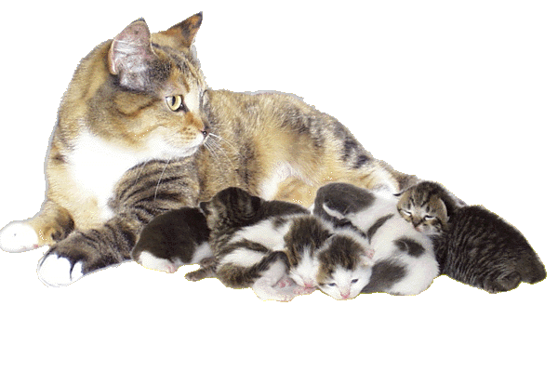
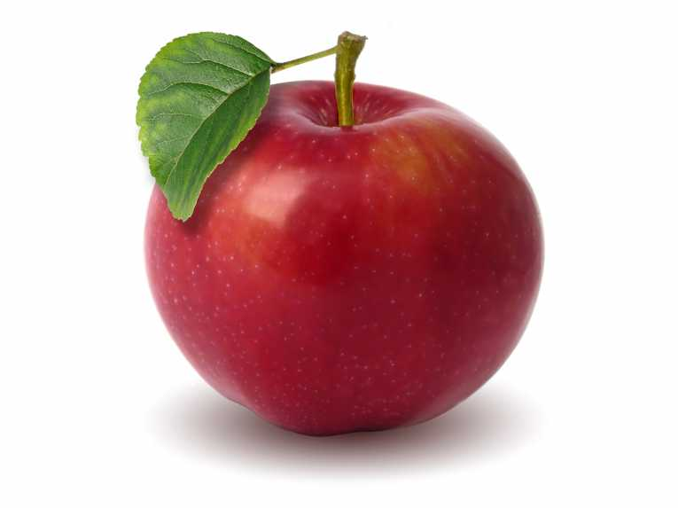
Disadvantages of Sexual Reproduction
It requires two individuals with opposing gametes (sex cells).
Organisms must use a lot of energy nourishing and growing a new baby organism.
Notes:
Yes, plants put a lot of energy into growing new baby plants… Seeds anyone? It takes a lot of energy to produce all the crap tons of pollen in the air and to make fruits/nuts.

Slide 21
Comparison Asexual and Sexual Reproduction
Asexual
Sexual
Number of parents
What do offspring look like?
DNA
One parent
2 parents
Different from parents but still similar
Identical to parent
Combined DNA of 2 parents
Same as parent

Slide 22
Asexual
DNA
DNA
Sexual
DNA
DNA
DNA
+
Sperm
Egg
Zygote

Slide 23
Asexual
All offspring identical – no variation
DNA
DNA
Sexual
DNA
DNA
DNA
+
DNA
or
DNA
DNA
or
All offspring different – considerable variation
DNA
DNA

Slide 24
Define asexual reproduction.
Asexual reproduction – only one parent and the offspring are identical to parents

Slide 25
Define sexual reproduction.
Sexual reproduction – requires two parents (or two sex cells) and the offspring are more diversified

Slide 26
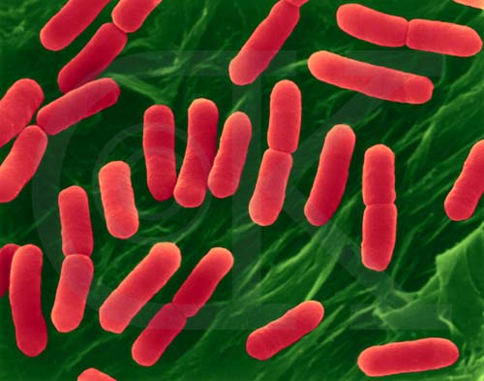
What type of asexual reproduction is the picture below?
Binary fission

Slide 27
What type of asexual reproduction is the picture below?
Budding

Slide 28
Which type of reproduction will give you a wider diversity of offspring?
Sexual reproduction

Slide 29
What type of asexual reproduction is the picture below?
Vegetative propagation

Slide 30
What type of asexual reproduction is the picture below?
Regeneration

Slide 31
Which type of reproduction will produce offspring identical to the parent?
Asexual reproduction

Slide 32
In your notes, draw a Venn Diagram comparing asexual and sexual reproduction.
Asexual
Sexual

