Slide 1
DNA

Slide 2
DNA
What is DNA and Why is it important?
DNA stands for deoxyribonucleic acid.
The chromosomes in the nucleus of a cell contains a code.
This code is in the form of a chemical called deoxyribonucleic acid. (DNA)

Slide 3
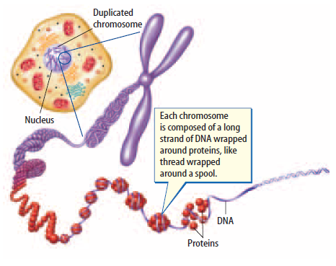
DNA
DNA is the master copy of an organism’s information code.
Every cell in your body contains your DNA.

Slide 4
DNA
History of DNA
Since the mid 1800’s, it has been known that the nuclei of the cells contains chemicals called nucleic acids.
Rosalind Franklin discovered that the DNA molecule was a strand of molecules in spiral shape.
Using X-ray technique Dr. Franklin showed that the molecule was so large it was probably made up of two spirals.
The structure of DNA is similar to the handrails and steps of a spiral staircase.

Slide 5
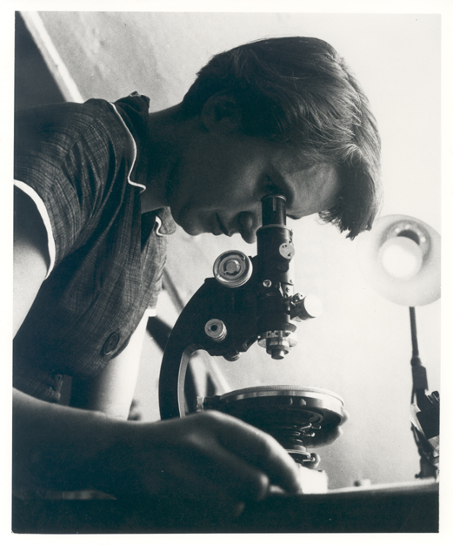
DNA
Rosalind Franklin

Slide 6
DNA
DNA Model
James Watson and Francis Crick made a model of a DNA molecule using the work of Dr. Franklin and others.
Watson and Crick determined the sides (handrails of the stairs) of the DNA molecule are made up of two twisted strands of SUGAR and PHOSPHATE molecules.

Slide 7
Watson and Crick
James Watson and Francis Crick studied the structure of DNA
Watson, Crick, Franklin video with Journal Entry!
Do not copy!!!

Slide 8
DNA
C (DNA Model) -1 (Watson and Crick Model)
The “stairs” that hold the two sugar phosphate strands (hand rails) apart are made up of molecules called nitrogen bases.

Slide 9
DNA
Four types of Nitrogen Bases in DNA
Adenine (represented with an A)
Guanine (represented with a G)
Cytosine (represented with a C)
Thymine (represented with a T)

Slide 10
DNA
C. DNA Model (continued)
Watson and Crick discovered that the nitrogen bases ALWAYS occur in pairs.
The Watson and Crick model shows that:
Adenine pairs Thymine (A-T)
Cytosine pairs with Guanine(C-G)
Each base pairs up only with its correct partner!!!!
To remember which pairs go together: AT = apple tree and CG = Coast Guard

Slide 11
DNA
How DNA Copies Itself
When chromosomes are doubled at the beginning of cell division, the amount of the DNA in the nucleus is doubled.
This process is called DNA REPLICATION.

Slide 12
DNA
How DNA Copies Itself
Steps of DNA Replication
An enzyme breaks the bonds between the nitrogen bases; the two strands separate.
The bases attached to each strand then pair up with new bases from a supply found in the cytoplasm.
Adenine pairs with Thymine, Cytosine pairs with Guanine.
The order of the base pairings of DNA will match the order in the original DNA!!

Slide 13
DNA
How DNA Copies Itself
Steps of DNA Replication
Sugar and phosphate groups from the side of each new DNA strand.
Each new DNA strand contains one strand of original DNA and one new strand of DNA
Show video clip of DNA Replication.

Slide 14
DNA
Genes
DNA is important because all of the characteristics that you have are affected by the DNA that you have in your cells.
It controls things like eye color, hair color, and whether you can digest milk.
These characteristics are called TRAITS.
How traits appear in you depends on the kinds of proteins your cells make.
DNA stores the blueprints for making proteins.

Slide 15
DNA
Genes
Proteins are made up of amino acids.
Amino acids are linked in a certain order.
The chain can be hundreds or thousands of amino acids to create one protein.
Changing the order of one amino acid would change the type of protein being made.

Slide 16
DNA
Genes
The section of DNA for a chromosome that directs the making of a specific protein is called a gene.
The gene gives the direction for the order in which amino acids will be made.

Slide 17
We have at least 30,000 different genes. Each of us has two copies of every gene. One set of copies is inherited from our mother, the other from our father. They are made up of a complex chemical called DNA (deoxyribonucleic acid). DNA controls all the processes which take place in our bodies by producing proteins which carry out the genes’ instructions.
When genes are damaged they may cause the production of abnormal proteins that lead to disease. It is known that cancer can occur due to changes in particular genes

Slide 18
RNA
RNA (ribonucleic acid)
Proteins are made by ribosomes. (remember?)
If the proteins are made by ribosomes, and genes found on chromosomes tell what amino acids to make in order to from proteins, how does the information leave the nucleus?(Do not copy this Question?)

Slide 19
RNA
RNA (ribonucleic acid)
The code for making proteins are carried from the nucleus to the ribosomes by RNA.
RNA is different from DNA
Made up of only one strand.
Contains a nitrogen base called Uracil (U) instead of Thymine (T).

Slide 20
RNA
RNA (ribonucleic acid)
Two different types of RNA are made from DNA in the nucleus.
Messenger RNA (mRNA)
Transport RNA (tRNA)

Slide 21
RNA
How does RNA work?
Protein assembly begins as mRNA moves out of the nucleus and attaches to the ribosomes in the cytoplasm.
Pieces of tRNA pick up amino acids in the cytoplasm and bring them to the ribosomes.
There tRNA temporarily matches up with mRNA and the amino acids become arranged according to the code carried by the mRNA.
The amino acids become bonded together and a protein molecule begins to form.

Slide 22
DNA and RNA
Part 1 video https://www.youtube.com/watch?v=qoERVSWKmGk&list=PLFCE4D99C4124A27A&index=34
Part 2 video https://www.youtube.com/watch?v=W4mYwsr9gGE&index=35&list=PLFCE4D99C4124A27A

Slide 23
Mutations
Mutations
Any permanent change in a gene or chromosome is called a mutation.
Causes of mutations:
Error during replication of a gene.
Occasionally a cell receives an entire extra chromosome.
Outside factors such as X-rays and chemicals have been know to change or breakdown chromosomes.

Slide 24
Mutations
Mutations
What Happens When Mutations Occur?
If a mutation occurs in a body cell it may or may not be life threatening.
If a mutation occurs in a sex cell then all the cells that are formed from that sex cell will have the mutation.

Slide 25
Mutations
Mutations
Are All Mutations Lethal? (Deadly)
Many mutations are harmful or deadly to organisms.
Some mutations do not appear to have any effect on the organism.
Mutations can be helpful in some organisms; they add variety and make them more resistant to certain diseases.

Slide 26
Mutations
Video Clip
https://www.youtube.com/watch?v=eDbK0cxKKsk
Mutations happen when A T (apple tree) or C G (coast guard) do not correctly pair together

