Slide 1
Functions of Our Organ Systems (Part 1)
What are the functions of each individual organ system?
How do the functions of organ systems interact?

Slide 2
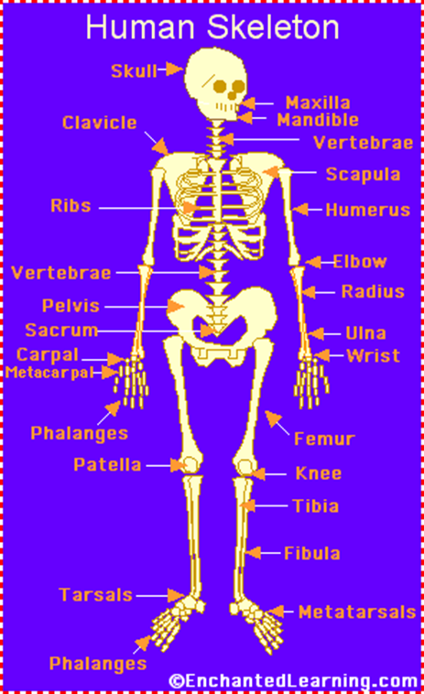
Skeletal System
The body’s framework
Gives shape and support
Protects internal organs
Skull protects brain, ribs protect heart and lungs
Major muscles are attached to help movement
Forms red and white blood cells in the long bones
Example the thigh bone or femur
Stores minerals for body use
Calcium and phosphorus
Major organs: bones and ligaments
Ligaments attach bone to bone

Slide 3
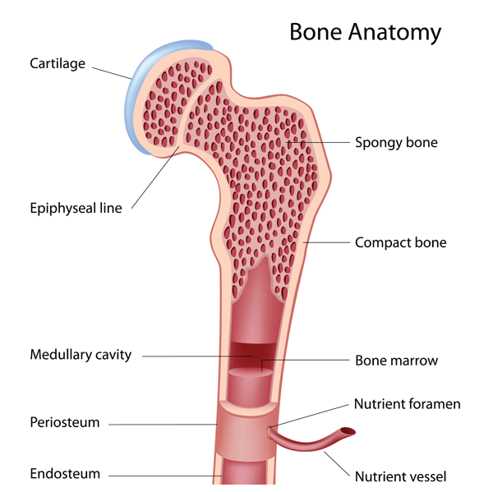
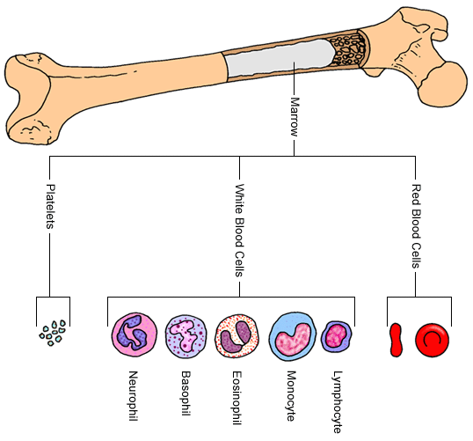
Skeletal System (Bone)
Bone
Made of connective tissue and minerals from cells called osteoblasts
Types of bone tissue compact (no visible open spaces) and spongy (many open spaces)
Marrow-soft tissue the fills the core of larger bones where the production of blood cells take place
Found in sternum, skull, pelvis, humerus, and femur

Slide 4
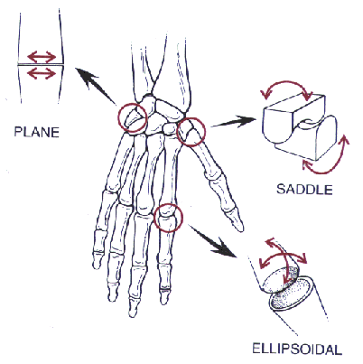
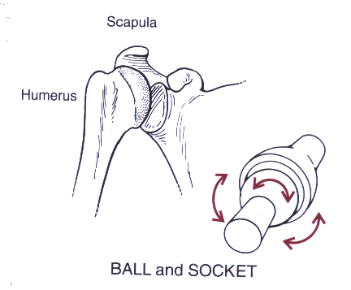
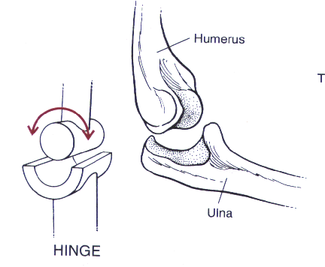
Skeletal System (Joints)
Joints can be classified as
a type of simple machine-
the lever. The lever is a
rigid bar that moves on a
fulcrum (triangle).
Sliding Joint Hinge Joint Ball and Socket Joint
Sliding joints allow bones Like the hinge on a door, Like the joystick on a
In the hand to glide over the arm is able to flex to computer game, the one another, giving some extend the lower arm shoulder enables you arm
flexibility to the area to move in all directions

Slide 5
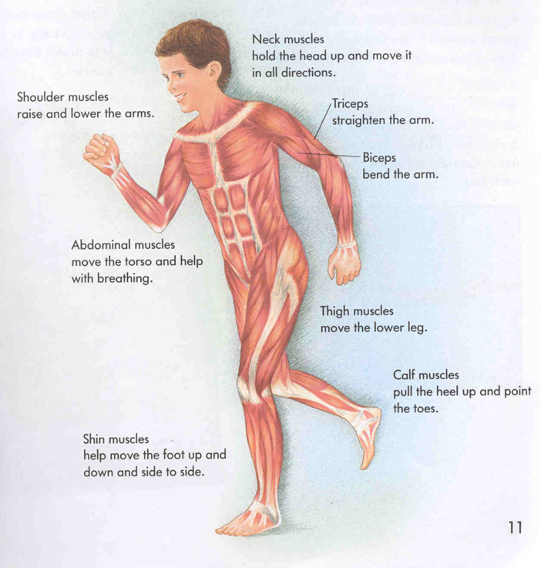
Muscular System
The organs that relax, contract, and provide the force to move your body parts
Movement
How we move
The production of thermal energy (heat)
Gives shape to the body
Major organs: muscles and tendons
Tendons attach muscles to bones

Slide 6
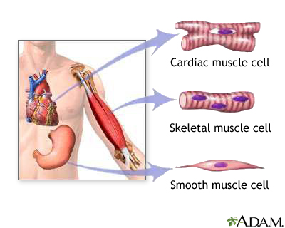
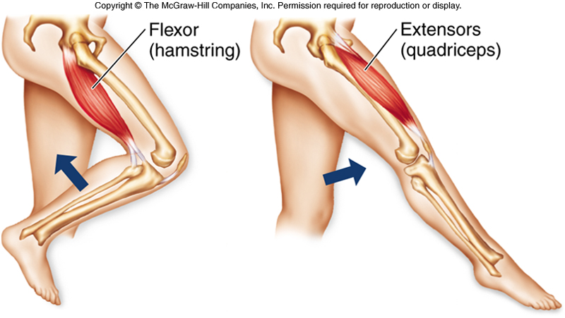
Muscular System (Types of Muscles)
Smooth Muscle
Found in digestive track and blood vessels
Cardiac Muscle
Found only in the heart
Skeletal Muscle
Attached to bones for movement and protection of inner organs
Work in pairs to bend the body part (flexor muscle) or to straighten the body part (extensor)

Slide 7
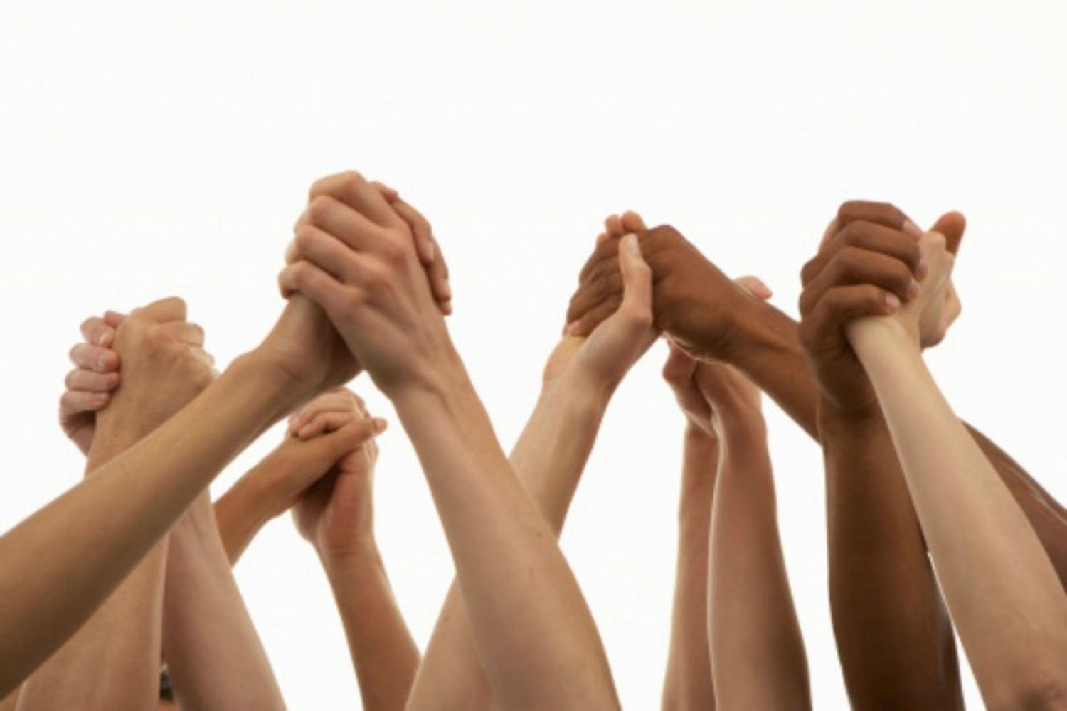
Integumentary System
Skin-the largest organ in the body
Vital role in protecting the body
Sensory response
Formation of vitamin D
Regulation of body temperature
Ridding the body of wastes
Contains melanin, which is a chemical
that determines skin color
Major organs: skin, hair, nails

Slide 8
Integumentary System (Skin)
Layers of the skin
Epidermis-made of epithelial tissue. The cells are dead and filled with proteins called keratin which makes the skin tough
Dermis-lies under the epidermis and contains fibers made of protein call collagen that allow the skin to bend without tearing
Blood vessels transport substances and help regulate body temperature
Nerves carry messages to and from the brain
Muscle fibers attached to hair follicles can contract, causing the hair to stand up
Oil glands release oil that keeps hair flexible and helps waterproof the epidermis
Sweat glands release sweat. As sweat evaporates, the body is cooled. Sweat also contains waste materials taken out of the body.

Slide 9
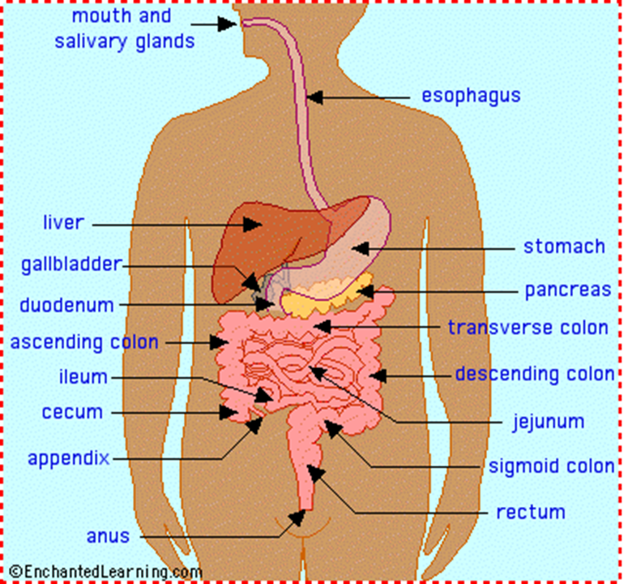
Digestive System
Makes the food you eat available to your cells
Breaks down food into small molecules that can be absorbed and moved into the blood
Unused molecules pass out of body as wastes
Major Organs: (food travels through) mouth/teeth, esophagus, stomach, small and large intestines, rectum, anus

Slide 10
Digestive System
Nutrition
Six kinds of nutrients are available in food
Proteins, carbohydrates, fats, vitamins, minerals and water
Organic nutrients all contain carbon
They are proteins, carbohydrates, and fats
Inorganic nutrients do not contain carbon
They are vitamins, minerals and water
Foods containing proteins, carbohydrates, and fats need to be broken or digested before the body can use them
Water, vitamins, and minerals don’t require digestion and are absorbed directly into the bloodstream.

Slide 11
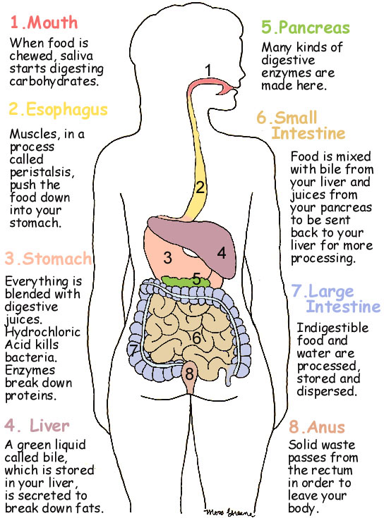
Digestive System
Digestion starts with the mouth.

Slide 12
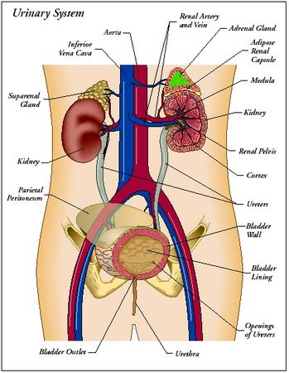
Excretory System
Eliminates wastes so the body can remain healthy
Kidneys filter blood through nephrons. Nephrons remove toxic or harmful substances from the body
Excretion
Major organs: kidneys, nephron, utterers, bladder, urethra

Slide 13
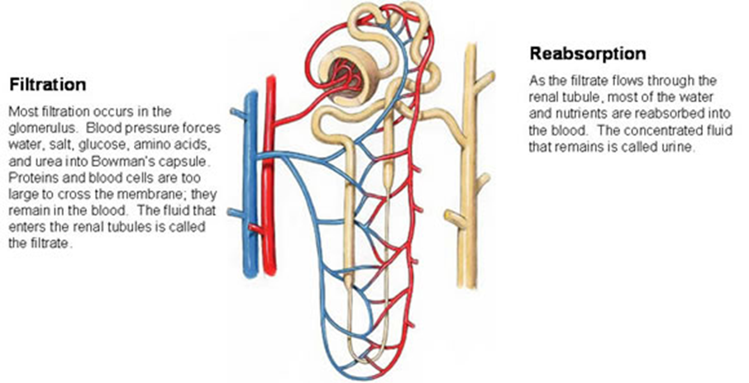
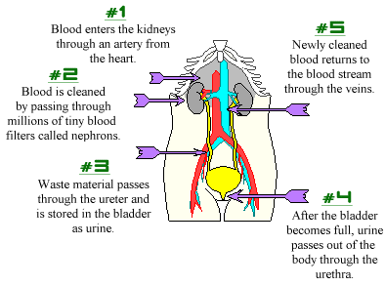
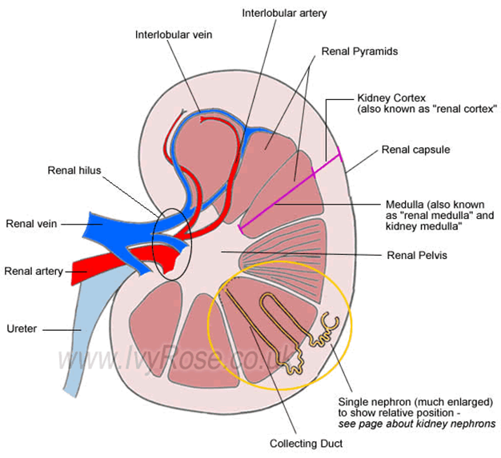
Excretory System
Nephron

Slide 14
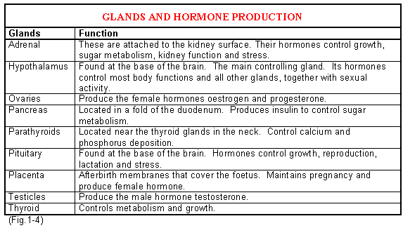
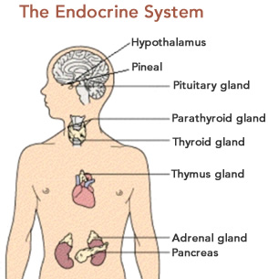
Endocrine System
Uses chemicals (hormones) to control many systems in the body
Enables many parts of the body to respond immediately in a fearful situation by adrenal glands production of adrenaline
Major Organs: glands

Slide 15
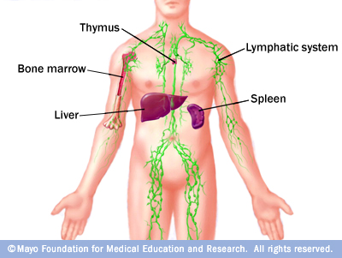
Lymphatic System
Helps protect the body from infection and disease
Returns collects and returns excess fluids back to the circulatory system
Uses lymphocytes a type of white blood cell to fight infection
Major Organs: lymph nodes, thymus, spleen, tonsils

Slide 16
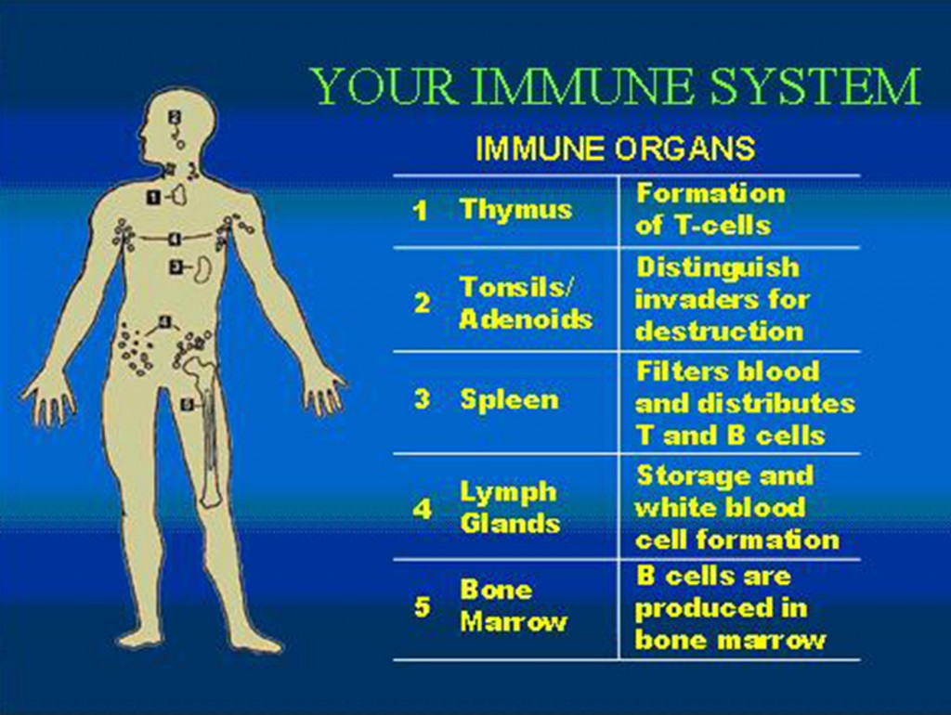
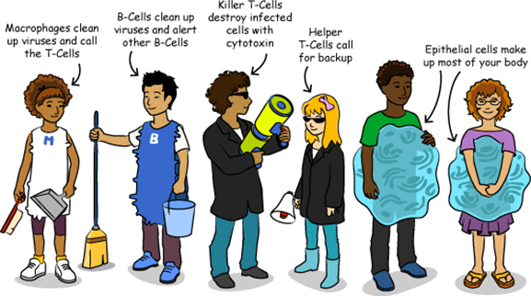
Immune System
Any organ, tissue, or cell that prevents pathogen form entering or surviving in the body is part of the immune system
Fights pathogens that the body is exposed to every day
Uses specialized blood cells

Slide 17
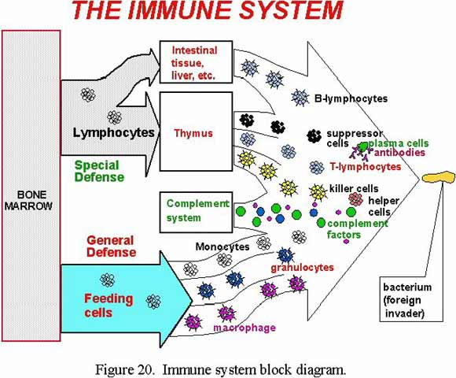
Immune System
1. An immune system cell known as a macrophage displays pieces of a pathogen on its surface for other immune cells to notice. These pieces are called antigens.
2. The antigens on the outside of the macrophage activate special cells called helper T Cells.
3. Helper T Cell divide as fast as they can to make more Helper T Cells.
4. The helper T cells send word to another kind of T cell called a killer T Cell which kills cells that have been infected by the pathogen. They recognize an infected cell because infected cells place antigens on its surface.
5. Helper T Cells also activate B cells. The B cells then make millions of antibodies.
6. The antibodies cling to many of the bacteria. The antibodies also act as markers. Once a bacterium has an antibody attached to it, all kinds of immune cells and proteins swarm to attack the pathogens.
7. Special proteins attach themselves to the antibodies stuck on pathogens. Then they punch holes in the sides of the pathogens, destroying them.
8. Macrophages engulf pathogens.

